Slide 1
Widget Extras
Focus Area: Front-end

Slide 2
Training Overview
Group Workshop
Back-end
Front-end
Services
Integration
Content
Services
Advanced
Security
Widget
Development
Widget Extras
Targeting
Publishing
Container
Development
Foundation
Portal Essentials
Portal Technologies
Portal Tools
Portal APIs

Slide 3
Objectives
Structured Content
Structured Content Types
Structured Content Items
Structured Content Widget
ICE Templates
Widget Chromes
Notes:
The goal of this module is for the trainees to get comfortable with a few things they will be using in their projects.
They need to learn how to create ICE templates, and how to add them in the existing ICE widgets. Creating a new ICE widget is out of scope for this training.
They need to learn how to create new chromes, add them in the portal manager, use them for widgets. Also, they need to understand when to use them.
In order to follow the various exercises in this training, you will need to refer to the training material available here:
https://github.com/Backbase/training-fe-module-02

Slide 4
Structured Content
The Basics

Slide 5
Overview
Page Instance
Structured
Content
Widget
Portal Catalog
Portal Content
Structured
Content
Widget
Structured
Content
Type
Structured
Content
Item
Server Catalog
Structured
Content
Widget
Structured
Content
Type
Notes:
https://my.backbase.com/resources/documentation/portal/5.6.0/overview_structuredcontent.html
Explain:
There are three key concepts:
Structured Content Type
Structured Content Item
Structured Content Widget
At the Enterprise level, you have the Structured Content Widget and some global Structured Content Types
At the Portal level, widget + types extend from Enterprise
In the Portal, you will create Structured Content items based on pre defined Types, and these items you will use in combination with the SC widget
You can extend the SC widget to add your own custom templates

Slide 6



Structured Content
Structured Content
Type
Structured Content
Widget
Structured Content
Items
Structured Content
Instances
Notes:
First of all, trainees need to understand what an ICE widget is:
An ICE widget is a widget aimed at integrating content from content services into Backbase Portal, along with offering In-Context Editing (ICE) capabilities.
The details of how the integration is happening is beyond the scope of this training.
An ICE widget renders the content based on ICE Templates. Give practical examples so that trainees can understand:
You want to display an image and some text, side by side. The content itself is stored in CS and you use a template with an img and a div tag floated left to render that content.
Or you might want a bulleted list
Or you might want a specific header
etc. etc.
Explain that under most circumstances you don’t need custom ICE widgets. You can use the default one and add your own templates. Custom widgets are needed when some enhanced functionality is needed.
https://my.backbase.com/docs/product-documentation/documentation/portal/5.6.2/icewidgets_howiceworks.html#/list

Slide 7
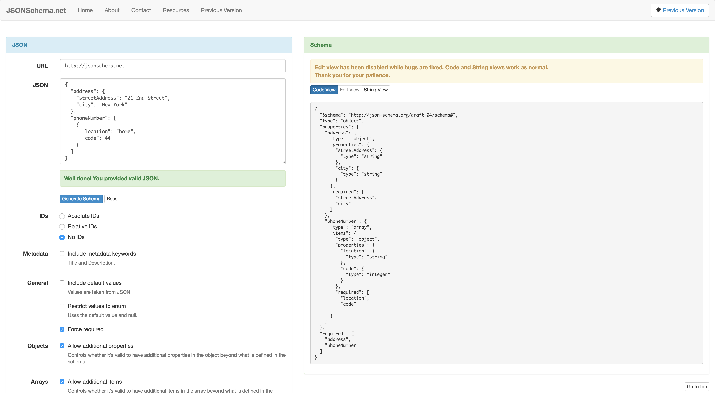
Structured Content
Structured Content Type:
It’s a template for your data.
Content Type are created using the JSON Schema Standard.
JSON Schema can be used to:
Add validation to data.
Set the type of data to be stored.
Array.
Object
Image
Another Structured Content Item.
Set the type of input
Set default values
Structured Content
Type
http://jsonschema.net/
Notes:
First of all, trainees need to understand what an ICE widget is:
An ICE widget is a widget aimed at integrating content from content services into Backbase Portal, along with offering In-Context Editing (ICE) capabilities.
The details of how the integration is happening is beyond the scope of this training.
An ICE widget renders the content based on ICE Templates. Give practical examples so that trainees can understand:
You want to display an image and some text, side by side. The content itself is stored in CS and you use a template with an img and a div tag floated left to render that content.
Or you might want a bulleted list
Or you might want a specific header
etc. etc.
Explain that under most circumstances you don’t need custom ICE widgets. You can use the default one and add your own templates. Custom widgets are needed when some enhanced functionality is needed.
https://my.backbase.com/docs/product-documentation/documentation/portal/5.6.2/icewidgets_howiceworks.html#/list

Slide 8
JSON Schema Example
{ "$schema": "http://json-schema.org/draft-04/schema#", "title": "Buying Reason", "description": "Buying Reason Structured Content.", "type": "object", "properties": { "icon": { "title": "Icon", "type": "string", "metadata": { "infoText": "Drag on an icon image", "renderingHint": "image" } }, "title": { "title": "Title", "type": "string", "metadata": { "placeholderText": "Enter the reason title" } }, "description": { "title": "Description", "type": "string", "metadata": { "placeholderText": "Describe the essence of this reason" } } } }
Notes:
Explain roughly what JSON schema is about
Explain the BACKBASE Specific attribute: metadata
Explain placeholderText
Explain renderingHint
Explain there is also order and infoText
More info: https://my.backbase.com/resources/documentation/portal/5.6.0/structcontent_jsonschema.html

Slide 9
Content Widget Templates
Widget Extras

Slide 10
ICE Widget + Templates
Content Widget
Content
Templates
Notes:
First of all, trainees need to understand what an ICE widget is:
An ICE widget is a widget aimed at integrating content from content services into Backbase Portal, along with offering In-Context Editing (ICE) capabilities.
The details of how the integration is happening is beyond the scope of this training.
An ICE widget renders the content based on ICE Templates. Give practical examples so that trainees can understand:
You want to display an image and some text, side by side. The content itself is stored in CS and you use a template with an img and a div tag floated left to render that content.
Or you might want a bulleted list
Or you might want a specific header
etc. etc.
Explain that under most circumstances you don’t need custom ICE widgets. You can use the default one and add your own templates. Custom widgets are needed when some enhanced functionality is needed.
https://my.backbase.com/docs/product-documentation/documentation/portal/5.6.2/icewidgets_howiceworks.html#/list

Slide 11
ICE Templates
<div class="bt-ice-example"> <!-- image --> <img src="{{simpleContent.image.path}}" /> <!-- metadata --> <h2>{{simpleContent.article.bb:title}}</h2> <!-- article.content --> <div>{{{simpleContent.article.content}}}</div> <!-- link with attributes --> <a href="{{simpleContent.link.path}} ” title="{{simpleContent.link_desc.bb:title}}"> {{simpleContent.link_desc.content}} </a> <!-- Render widget properties --> <div title="{{title}}"> {{title}} </div> </div>
Notes:
ICE Templates are simply mustache templates which are rendered via a g:include.
Widget properties are passed here, so you have full access.
Explain {{{ vs {{ if needed - All variables are HTML escaped by default. If you want to return unescaped HTML, use the triple mustache: {{{name}}}.
https://my.backbase.com/docs/product-documentation/documentation//portal/5.6.2/contentservices_objectmodel.html#/list
https://my.backbase.com/docs/product-documentation/documentation//portal/5.6.2/objectmodel_bbtypes.html
Content Services
https://my.backbase.com/docs/product-documentation/documentation//portal/5.6.2/whatsnew_contentservices.html#/list
https://my.backbase.com/docs/product-documentation/documentation//portal/5.6.2/develop_contentservices.html#/list
The trainer needs to explain about CS Objects here.
Content Services
All content is saved in CS as an object with several metadata, and it has a specific type. Start with the bb:richtext type, and the article object in the example.
About the template tags:
- each tag is saved as a property of the widget’s instance
- the property makes reference to a content entry in content services
- although you can out any name you want for the property (before the dot), but the attributes (the part after the dot) are convention based on the cmis document object definition, you can use any cmis valid attribute (such as ‘cmis:name’), but we recommend using Backbase’s own attributes.
Content Management Interoperability Services (CMIS)

Slide 12
Exercise: Create an ICE Template
Create a custom content template named media-article.html, based on the Twitter Bootstrap Media Object: http://getbootstrap.com/components/#media
Make this template available in the templateList property of the content widget
Via the new extension system in CXP 5.6, it is very easy to extend Content Widgets to add your own custom templates.
Notes:
Media object is a concept introduced from Nicole Sullivan (@stubbornella) and it has been adopted by Bootstrap. Basically its an small template, with an image to the left and text to the right, which is nestable. More information here: http://www.stubbornella.org/content/2010/06/25/the-media-object-saves-hundreds-of-lines-of-code/
In this exercise you will learn how to extend the default ICE widget by creating your own ICE templates.
---------------------------------------------------------------------------------------------------------------------------------------------------
Students can get the ICE Widget from → statics/collection/target/collection-cxp-universal-1.0.0
If people do not have the default ICE widget, point them to here: https://repo.backbase.com/repo/com/backbase/universal/widgets/content/1.0/
https://my.backbase.com/docs/product-documentation/documentation//portal/5.6.2/icewidgets_customize.html
TODO - Check the ice template alt attribute for - <img class="media-object" src="{{article.image.path}}" />

Slide 13
Widget Chromes
Widget Extras

Slide 14
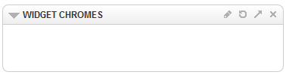
Widget Chromes
Mustache Template
widgetInstanceId
widgetContent
widgetTitle
preferences
Notes:
Start by explaining what the Chromes are.
Markup that wraps around your widget and you can use it to give common behavior to all your widgets.
Do a live demo, and show changing the chrome
Explain that “no-chrome” is still a chrome with nothing visible
Chromes are mustache templates. Explain all the variables that are passed from the portal in the template
https://my.backbase.com/docs/product-documentation/documentation//portal/5.6.2/widgets_chrome.html#/list

Slide 15
Widget Chromes
<div
data-pid="{{widgetInstanceId}}"
class="panel-chrome bp-widget {{#enableDND}}bp-ui-dragRoot{{/enableDND}}" >
<div class="bp-widget-head">
<div class="panel-heading">
<div class="panel-title pull-left">
{{#pref.icon}}
<i class="lp-icon lp-icon-{{pref.icon.value}}"></i>
{{/pref.icon}}
{{widgetTitle}}
</div>
</div>
<div class="panel-body bp-widget-body">{{{widgetContent}}}</div>
</div>
</div>
Notes:
If you didn’t mention in previous slide, talk about things like enableDD, showEdit etc (permission based properties)
Explain {{{ vs {{ if needed - All variables are HTML escaped by default. If you want to return unescaped HTML, use the triple mustache: {{{name}}}.
Show portalserver\target\portalserver\static\backbase.com.2012.aurora\html\chromes
Demo on how to include the Chrome:
uiEditingOptions.js - Webapps/portalserver/src/main/resources/conf/uiEditingOptions.js
Explain that you can define a specific list of chromes for the widget, in the index.html, via preferences - https://my.backbase.com/docs/product-documentation/documentation/portal/5.6.1/widgets_addproperties.html#/list
Set the chrome by modifying the portal model property, change directly on explorer

